Slide 1

Artificial intelligence based voice assistant
-Kiran pillai, a2305222528, 3 c.s.e.8y

Slide 2
Objective
The objective of this research paper is to investigate and analyze the applications, functionality, and impact of artificial intelligence-based voice assistants. The study aims to achieve the following objectives:
Examine the underlying technologies and algorithms employed in AI-based voice assistants, such as natural language processing, automatic speech recognition, ML & deep learning.
Investigate the functionality and features of voice assistants, including their ability to understand and respond to user queries, perform tasks, and provide personalized recommendations.
Assess the advantages and benefits of AI-based voice assistants, such as hands-free and eyes-free interaction, accessibility for individuals with disabilities, and their potential to enhance user experience.
Explore the challenges and limitations associated with voice assistants, such as privacy and data security concerns, accuracy in interpreting complex queries.
Investigate the future prospects and potential advancements in AI-based voice assistants, including their integration into various devices and environments, as well as their potential for emotional intelligence and conversational abilities.

Slide 3
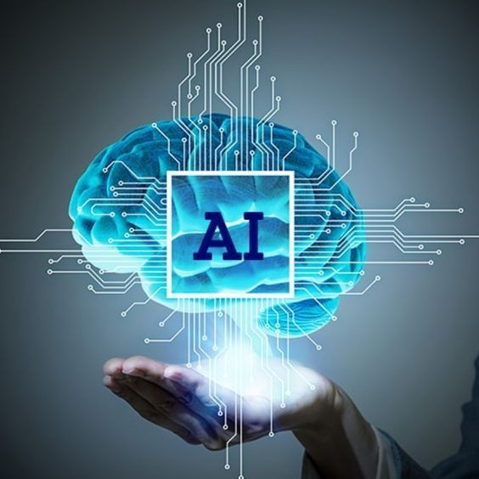
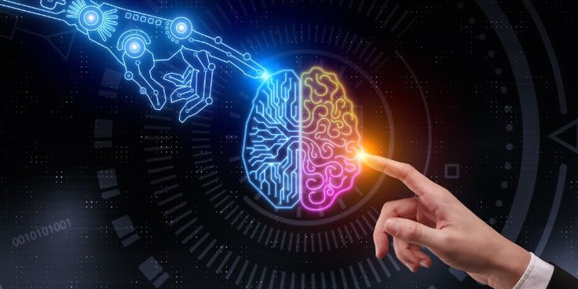
Introduction to ARTIFICIAL INTELLIGENCE
Artificial Intelligence (AI) voice assistants have become an integral part of our daily lives, transforming the way we interact with technology
Artificial Intelligence (AI) has emerged as a transformative technology with the potential to revolutionize various aspects of human life. It encompasses a wide range of computational systems and algorithms designed to mimic human intelligence and perform tasks that require human cognitive abilities. AI has gained significant traction in recent years, permeating domains like healthcare, finance, transportation, and entertainment.

Slide 4
What is artificial intelligence based voice assistant
Utilizes AI algorithms to enable voice based communication between humans and machines.
Employs natural language processing(NLP) & speech recognition technologies to inter[ret user queries spoken in natural language.
Capable of recognizing different accents, dialects, and speech patterns, making them accessible to a wide range of users.
Designed to provide real-time assistance, such as answering questions, performing internet searches, setting reminders, controlling smart devices, and more
Through ML & deep learning techniques, voice assistants can learn and adapt to user preferences, improving their accuracy and contextual understanding

Slide 5
Technologies involved
The core technologies enabling AI voice assistants include natural language processing (NLP), automatic speech recognition (ASR), machine learning (ML), and deep learning (DL).
NLP algorithms extract semantic meaning from spoken language, enabling the comprehension of user queries. ASR technology converts spoken language into written text, facilitating accurate command interpretation.
ML and DL algorithms allow voice assistants to learn and adapt to individual user preferences and contexts.

Slide 6
applications
Smart Home Control:
Voice assistants integrate with smart home devices, enabling users to control lights, thermostats, locks, through voice commands, creating a seamless smart home experience.
Information Retrieval:
Provide instant access to information by answering questions, searching web, and retrieving real-time updates on topics such as weather, news, sports scores, and general knowledge
Entertainment and Media:
They can play music, podcasts, audiobooks, and provide recommendations based on user preferences & can also control streaming services.

Slide 7
applications
They can search for movies or TV shows, and provide voice-guided navigation in media applications.
E-commerce and Shopping:
Voice assistants enable users to make purchases, add items to shopping lists, track orders, and provide personalized product recommendations, enhancing the shopping experience.

Slide 8
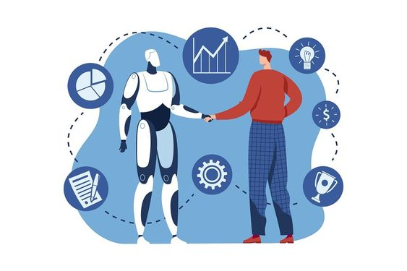
HOW it works?
AI-based voice assistants work by employing a combination of advanced technologies, including
1. natural language processing (NLP)
2. automatic speech recognition (ASR)
3. machine learning (ML).
STEPS
1. Speech Input:
The user speaks a command or query, which is captured by a microphone or the device's built-in microphone. The recorded audio is then sent for further processing.
2. Automatic Speech Recognition (ASR):
The captured audio is processed by ASR algorithms that convert the spoken language into written text. ASR technology ensures accurate transcription of the user's speech, forming the basis for further analysis.

Slide 9
3. Natural Language Understanding (NLU):
The transcribed text is analyzed by NLP algorithms to interpret the user's intent and extract relevant information. NLU enables the voice assistant to understand the context, meaning, and nuances of the user's command or query.
4. Intent Recognition and Action:
Based on the interpreted text, the voice assistant identifies the user's intent or the desired action. It determines the appropriate response or action needed to fulfill the user's request. This may involve retrieving information from a database, performing a specific task, or initiating a dialogue for further clarification.
5. Response Generation:
Once the intent is recognized, the voice assistant generates a response. This response can be in the form of spoken words, visual feedback, or a combination, depending on the device or platform. The generated response is designed to provide relevant information or execute the requested action.

Slide 10
VARIOUS TYPES OF AI
Personal Voice Assistants:
These voice assistants are designed to assist individuals with personal tasks, such as scheduling appointments, setting reminders, sending messages, and providing general information.
Ex. Siri (Apple), Google Assistant, and Alexa (Amazon Echo).
Business Voice Assistants:
These cater to business-related tasks and functions. They can schedule meetings, access enterprise data, provide sales reports, and assist with customer interactions.
Ex. IBM Watson Assistant and Microsoft Cortana
Smart Home Voice Assistants:
These focus on controlling and managing smart home devices. They allow users to control lights, thermostats, security systems, and other connected devices using voice commands.
Ex. Google Assistant (Google Nest) and Alexa (Amazon Echo).
Virtual Assistants for Specific Industries:
Some voice assistants are designed for specific industries, such as healthcare, finance, and hospitality. They offer specialized functionalities, like providing medical advice, financial analysis, or hotel recommendations, tailored to the respective industry's needs.

Slide 11
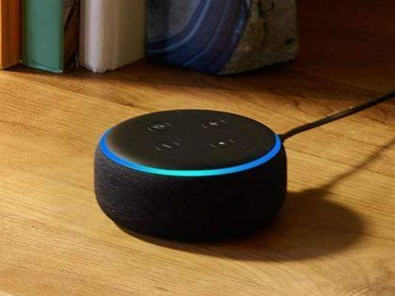
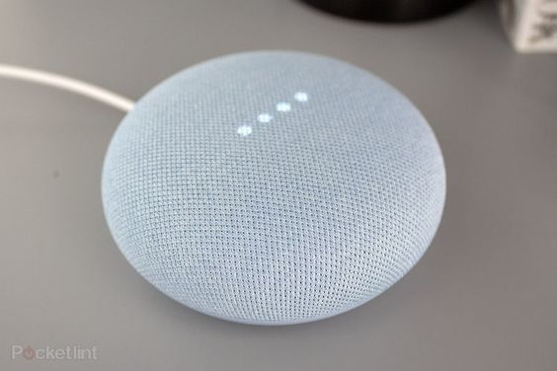
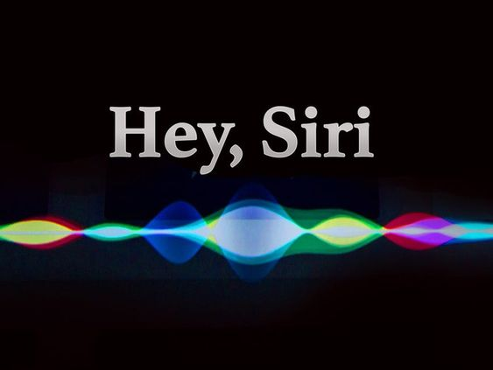
Voice Commerce Assistants:
These assistants are primarily focused on facilitating voice-based shopping experiences. They can help users browse products, make purchases, track orders, and provide personalized recommendations.
Ex. Amazon's Alexa and Google Assistant's shopping capabilities.

Slide 12
Path used in ai based voice assistant
The development and implementation of AI-based voice assistants typically involve several key steps. Here are the main stages involved in creating a voice assistant:
Data Collection:
Large volumes of data, including voice recordings and transcriptions, are collected to train the voice assistant. This data is used to create a robust training set enabling the assistant to recognize and understand various accents, languages, and speech patterns.
Natural Language Processing (NLP):
NLP techniques are applied to process and analyze the collected data. This involves tasks such as speech recognition, language understanding, and language generation. NLP algorithms help convert spoken language into text, extract meaning from user queries, and generate appropriate responses.
Machine Learning (ML):
ML models are trained using the collected data to enable the voice assistant to learn and improve over time. Supervised learning techniques are used to teach the assistant how to recognize and classify speech patterns and intent. Reinforcement learning can also be employed to refine the assistant's responses based on user feedback.

Slide 13
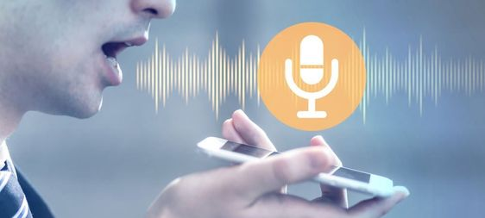
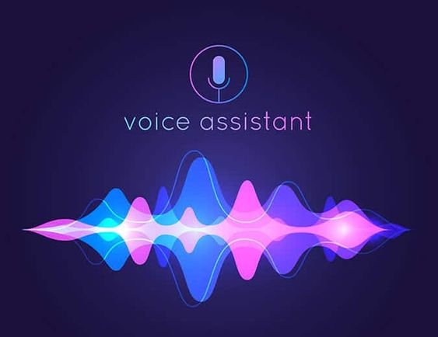
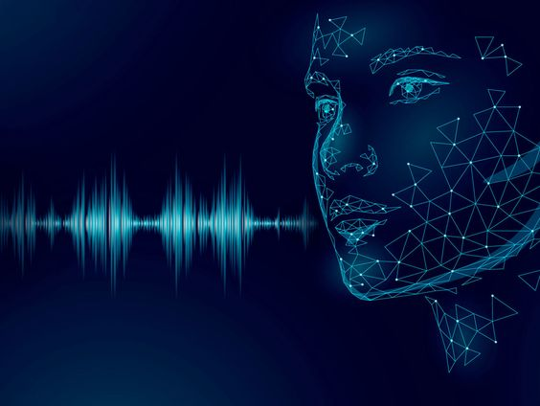
Integration of APIs and Services:
Voice assistants are integrated with various APIs and services to expand their functionalities. This includes accessing databases, connecting to third-party applications, and incorporating external services like weather updates, news feeds, and location services.
Voice User Interface (VUI) Design:
Designers and developers create a user-friendly VUI that allows users to interact with the assistant through voice commands. The VUI should be intuitive, clear, and capable of understanding user prompts accurately.
Continuous Improvement:
Voice assistants are constantly refined and enhanced through user feedback and ongoing iterations. User interactions and queries are analyzed to identify areas of improvement, refine language models, and enhance the overall user experience.

Slide 14
Advantages of ai
Convenience
provide a hands-free and natural way of interacting with devices and services. Users can perform various tasks, such as setting reminders, sending messages, or controlling smart home devices, simply by speaking, without the need for manual input.
Efficiency
enable faster and more efficient task completion. Voice commands are typically processed in real-time, allowing for quick execution of tasks and reducing the time required to navigate through menus or interfaces.
Accessibility
cater to individuals with disabilities or those who have difficulty using traditional input methods. Voice-based interaction ensures inclusivity, allowing a broader range of users to access and utilize technology

Slide 15
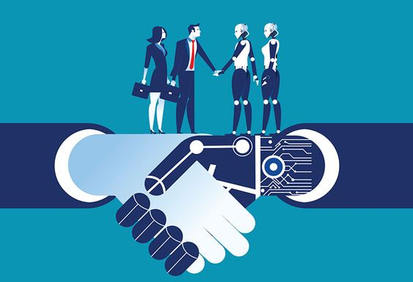
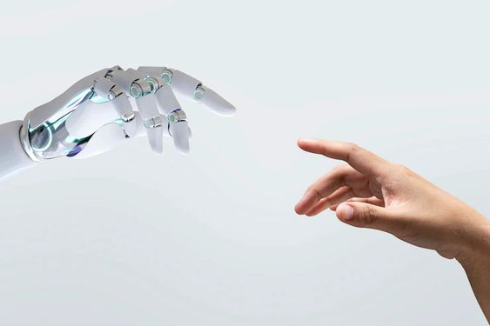
Advantages of ai
Personalization
can learn and adapt to individual users' preferences and behaviors over time. They can provide personalized recommendations, tailored content, and customized experiences based on user history and preferences.
Multi-tasking
enable multitasking capabilities by allowing users to perform tasks simultaneously. Users can, for example, listen to music while asking for weather updates or set timers while cooking.

Slide 16
disAdvantages of ai
Privacy Concerns
They often process and store user interactions and personal data, raising privacy concerns. There is a risk that sensitive information could be accessed or misused, leading to potential breaches or unauthorized access to personal data.
may misinterpret or misunderstand user commands, leading to incorrect or unintended actions. Language complexities, accents, and background noise can sometimes result in inaccurate responses or frustrating user experiences.
Misinterpretat-ion
and Errors
Security Risks
could be susceptible to security vulnerabilities and hacking attempts. If compromised, they may be used to gain unauthorized access to devices, networks, or sensitive information, posing a potential security risk.

Slide 17
disadvantages of ai
Dependency and Reliance
They often process and store user interactions and personal data, raising privacy concerns. There is a risk that sensitive information could be accessed or misused, leading to potential breaches or unauthorized access to personal data.
may struggle to understand context or intent beyond the immediate command. They often lack the ability to interpret nuanced queries or engage in complex conversations, limiting their effectiveness in certain scenarios..
Lack of Contextual Understanding

Slide 18
conclusion
AI-based voice assistants have emerged as powerful and increasingly ubiquitous tools that offer numerous advantages and convenience to users. They have revolutionized the way we interact with technology, providing a hands-free and natural interface for accessing information, performing tasks, and controlling various devices.
They allow users to access services and perform tasks quickly and effortlessly, promoting multitasking and streamlining daily routines. The ability to personalize experiences and adapt to individual preferences further enhances the user experience
However, it is essential to recognize the potential drawbacks and challenges associated with AI-based voice assistants. Privacy concerns, misinterpretation errors, and the risk of over-reliance are critical considerations that need to be addressed. Striking a balance between convenience and safeguarding personal data is crucial to ensuring user trust and security.
AI-based voice assistants have the potential to reshape our interactions with technology, making them more natural, accessible, and user-friendly. With careful attention to user privacy, data security, and ethical considerations, voice assistants can continue to evolve as valuable tools that enhance our daily lives, foster productivity, and contribute to a more seamless and connected future

Slide 19

References
1. https://www.educba.com/voice
2. https://recfaces.com
3. https://www.arm.com/glossary
4. https://en.wikipedia.org/wiki/Voice_Assistant
5. https://www.superannotate.com/blog/ai-overview
6. https://www.geeksforgeeks.org/ai
7. https://www.simplilearn.com/ai-and-ml-article
8. https://recfaces.com/articles
9. https://www.cronj.com/blog/pattern-recognition-types-use-cases/
10.https://www.elprocus.com/aiworking-and-its-applications/

Slide 20
Thank you :)

